Slide 1


Foundations of
Scientific Computing
(SciComp 101)
Dave Biersach
dbiersach@bnl.gov
Session 04
Algorithms

Slide 2
Session 04 – Goals
Understand the syntax and motivation for the Unix shebang and docstrings
Utilize the main guard and a main() function to clearly designate the place where your Python script starts
Review how to define a custom (user-defined) function using the def keyword
Convert integers to and from Base 10 (decimal) and Base 2 (binary)
Implement a while loop to repeatedly execute code until a test condition obtains a desired value

Slide 3
Session 04 – Goals (cont.)
Learn about the Hamming weight (popcount) of an integer and consider algorithm efficiency
Write code to factor a quadratic expression
Implement an if/else clause to support conditional code execution
Consider how to sort a list of integers using the Bubble Sort algorithm
Instrument code to time its performance for comparative reference to potentially faster algorithms

Slide 4
The Unix Shebang
https://en.wikipedia.org/wiki/Shebang_(Unix)
It is a common convention in UNIX shell (command line interface or CLI) scripts to specify, in the first line of the file, the name of the program the OS should use to interpret/execute the script
This is also known as the Unix shebang:
A Unix-derived OS will run the env shell command, which then locates the uv executable and then calls run
It respects Python virtual environments (.venv)
On MS Windows, you must explicitly type uv run followed by the name of the Python script you want to execute

Slide 5
Docstrings and PEP 257
https://peps.python.org/pep-0257
A docstring is a string literal that occurs as the first statement in a module, function, class, or method definition
It should be a concise summary of the purpose of the script
It should explain the intent and the audience of the code
For consistency, always use """triple double quotes""" around docstrings
The format and use of docstrings is covered in PEP 257
Tools like help(), pydoc, IDE tooltips, and documentation generators can display docstrings automatically, keeping docs close to the code

Slide 6
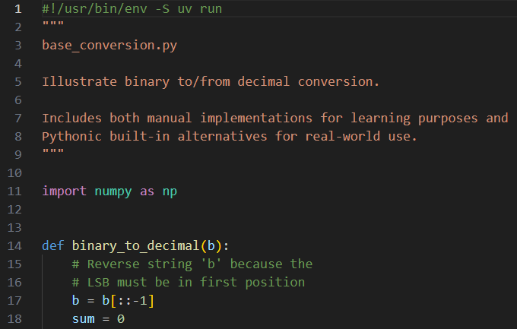
Open base_conversion.py
DO NOT edit
this code
①
The Unix shebang
②
Triple quote
A docstring
③
Triple quote

Slide 7
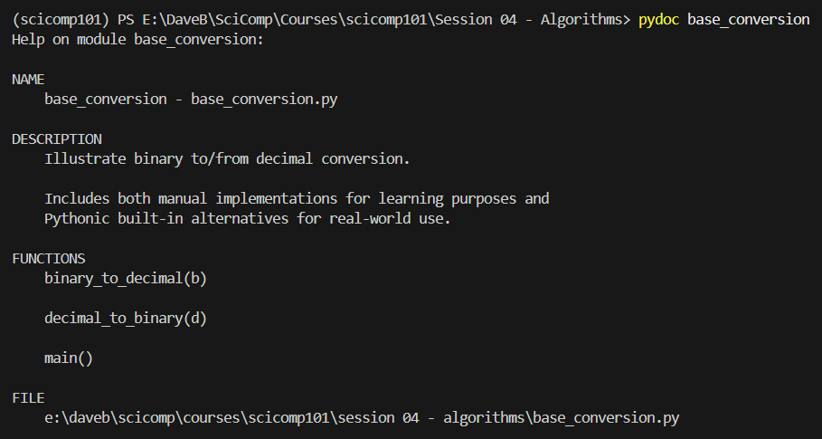
Running pydoc on base_conversion
①
②
③
④

Slide 8
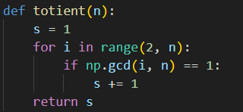
Defining a function
def is how we define a function
The function name
The inbound parameter(s)
A function introduces a scope
Functions are just "named" scopes!
Functions can return a value

Slide 9
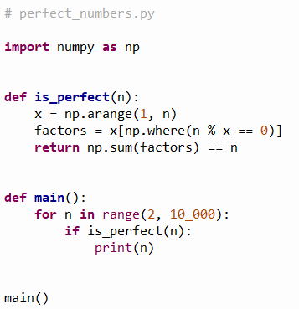
The most important function: main()
Functions are not executed (run) until they are explicitly called. The def keyword merely defines a function but does NOT run it
By convention, programmers use main() as the name of the first function they want the computer to call when starting the program
This is the first line of executable code in the program, and its sole purpose is to call your custom main() function
Your program now starts at the first statement in main()

Slide 10

The Python main() Guard
https://docs.python.org/3/library/__main__.html
The main guard is typically at the end of a script file
It prevents unintended execution on import as it ensures code runs only when the file is executed directly, not when it is imported as a module
It distinguishes “script” vs “library” behavior because it lets the same file act as either a runnable program or a reusable module (imported into other scripts)
It is a Python convention, not a requirement - the main guard is idiomatic and widely used, but Python does not enforce it. Consider it a best practice

Slide 11
Base Conversion – Binary to Decimal
Position 6
Position 0
Most Significant Bit (MSB)
Least Significant Bit (LSB)
$$Weight={Base}^{Position}$$
1011001₂ = 89₁₀
← LSB
← MSB

Slide 12
Base Conversion – Decimal to Binary
Most Significant Bit (MSB)
Least Significant Bit (LSB)
% = Remainder (Mod)
// = Floor (Integer)
113₁₀ = 1110001₂
← LSB
← MSB

Slide 13
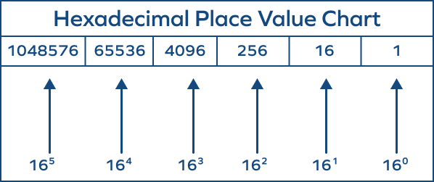
Hexadecimal (Base 16)

Slide 14
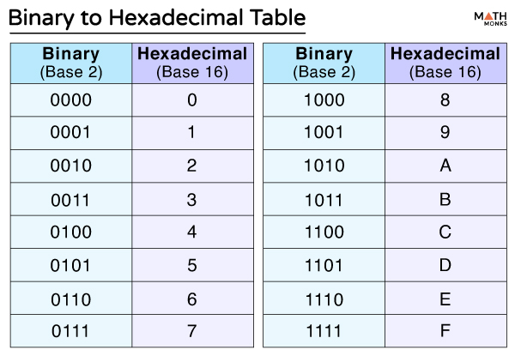
Hexadecimal (Base 16)

Slide 15
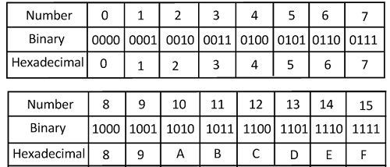
Hexadecimal (Base 16)

Slide 16
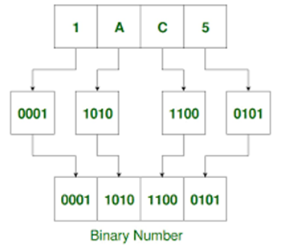



Hexadecimal (Base 16)
3
2
1
0
= 6,853₁₀
1₁₀
10₁₀
12₁₀
5₁₀
$$1×{16}^{3}=1×4096=4096$$
= 6,853₁₀
$$10×{16}^{2}=10×256=2560$$
$$12×{16}^{1}=12×256=192$$
$$5×{16}^{0}=5×1=5$$
$$4096+2560+192+5=6853$$

Slide 17
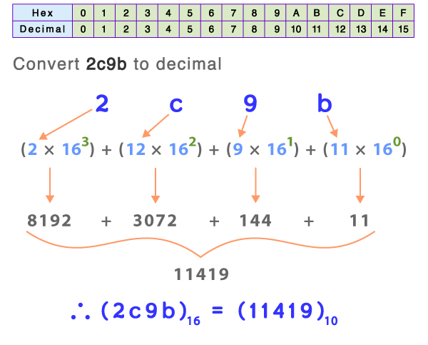
Hexadecimal (Base 16)

Slide 18
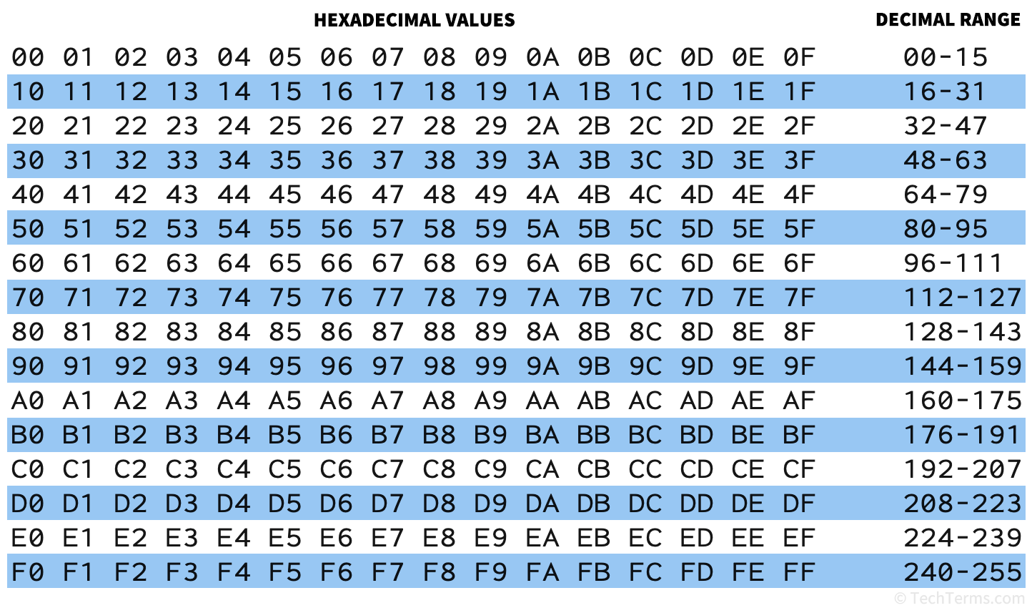
Hexadecimal (Base 16) – One Byte

Slide 19
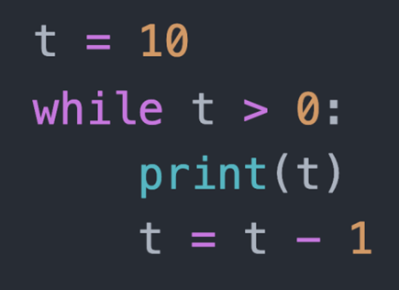
while Loop
A while loop executes all the statements within its scope as long as the loop conditional remains True
The loop conditional
A while loop introduces a scope

Slide 20
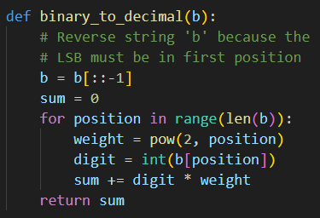
View base_conversion.py
DO NOT edit
this code
①
②
③
④
⑤
⑥
⑦
⑧

Slide 21
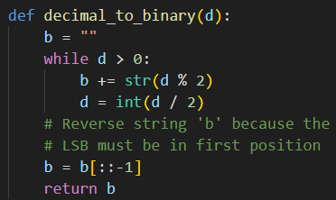
View base_conversion.py
DO NOT edit
this code
①
②
③
④
⑤
⑥
⑦

Slide 22
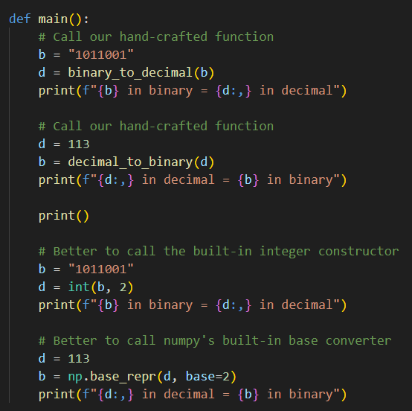
View base_conversion.py
DO NOT edit
this code
①
②
③
④
⑤
⑥
⑦
⑧
⑨

Slide 23
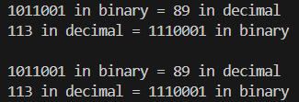
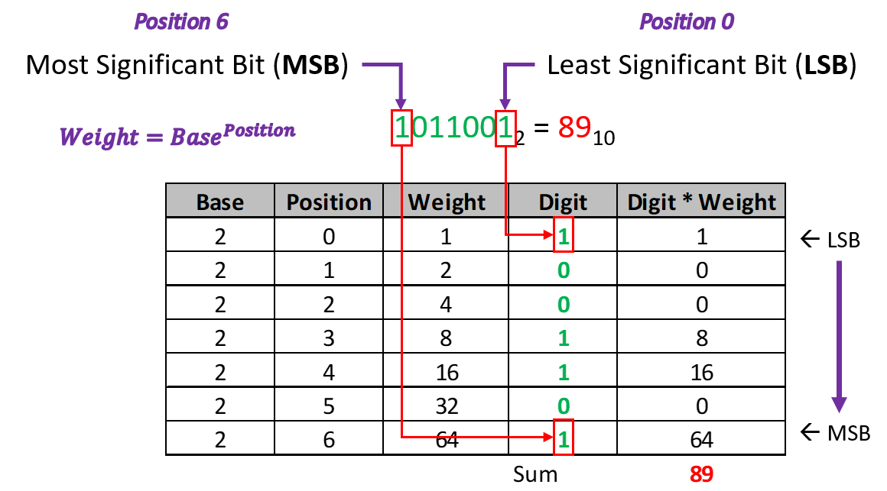
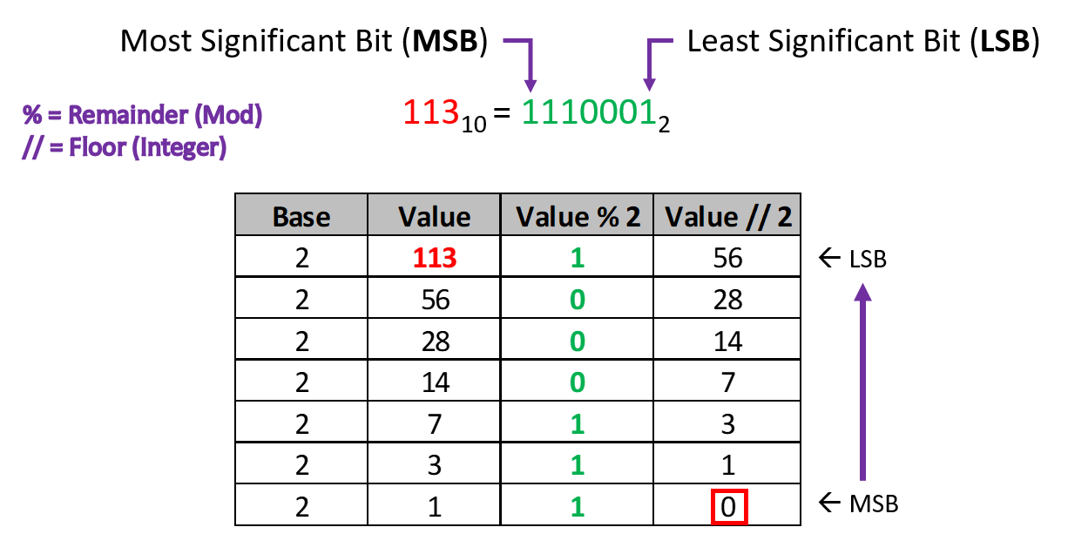
Run base_conversion.py
①
②

Slide 24
Hamming Weight
The number of ones (1) bits in the binary (Base 2) representation of a non-negative integer (a whole number) is called its population count (aka popcount, stemming from which positions are populated by 1’s)
In 1950, while working at Bell Laboratories, Richard Hamming (1915-1998) published the first paper on “Error Detecting and Error Correcting” based upon the concept of the Hamming Weight, which is what we now call popcount
The Control Data Corporation CDC6000 mainframe computer (designed by Seymour Cray in 1964) was the first computer to include a single CPU instruction that could return the popcount of an integer

Slide 25
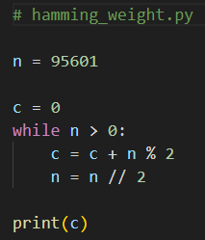

Edit hamming_weight.py
You must type in this code
Write code to determine the Hamming Weight of $95,601$
①
You must create this file and type this code exactly
②
counter
③
④
Mod (Remainder)
⑤
Floor (Integer) Division
⑥

Slide 26
Run hamming_weight.py
Write code to determine the Hamming Weight of $95,601$
①
95601₁₀ = 10111010101110001₂

Slide 27
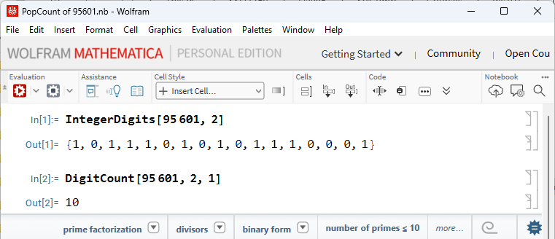
Always Seek Independent Confirmation
Write code to determine the Hamming Weight of $95,601$
①
②

Slide 28
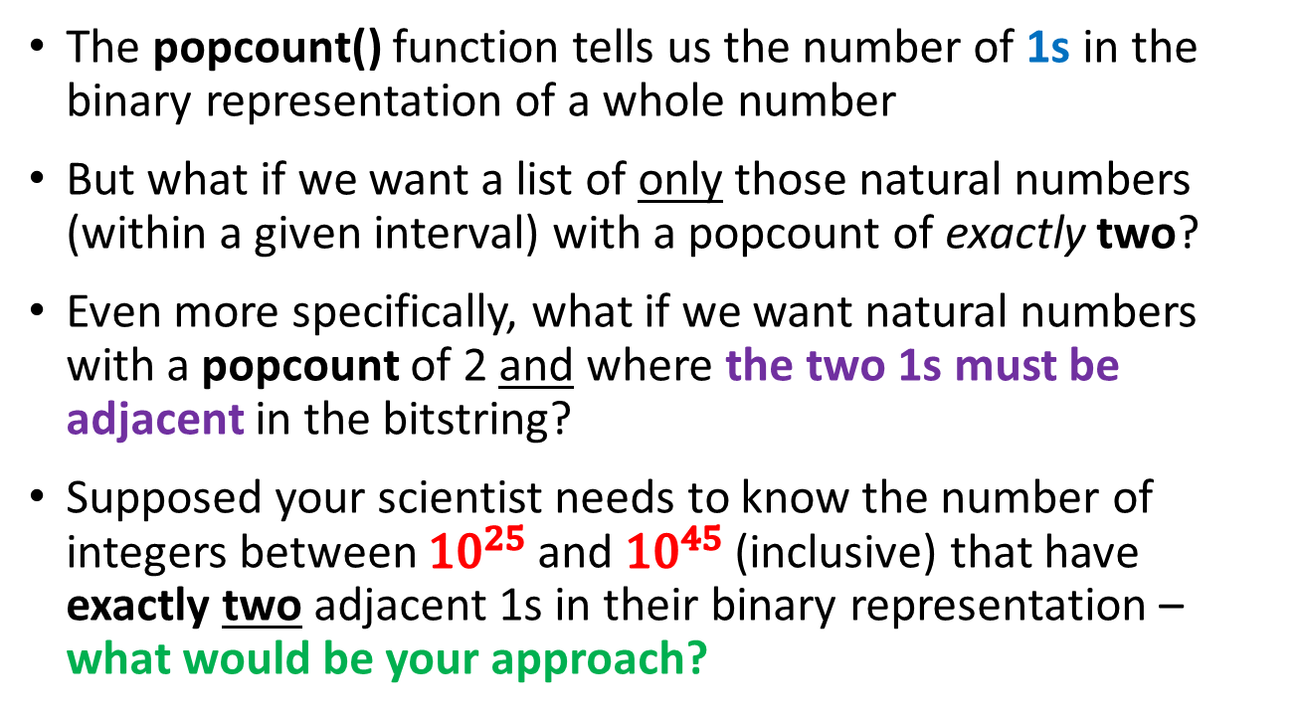
Two Adjacent Bits
The popcount() function tells us the number of 1s in the binary representation of a whole number
But what if we want a list of only those natural numbers (within a given interval) with a popcount of exactly two?
Even more specifically, what if we want natural numbers with a popcount of 2 and where the two 1s must be adjacent in the bitstring?
Supposed your scientist needs to know the number of integers between ${10}^{25}$ and ${10}^{45}$ (inclusive) that have exactly two adjacent 1s in their binary representation – what would be your approach?

Slide 29
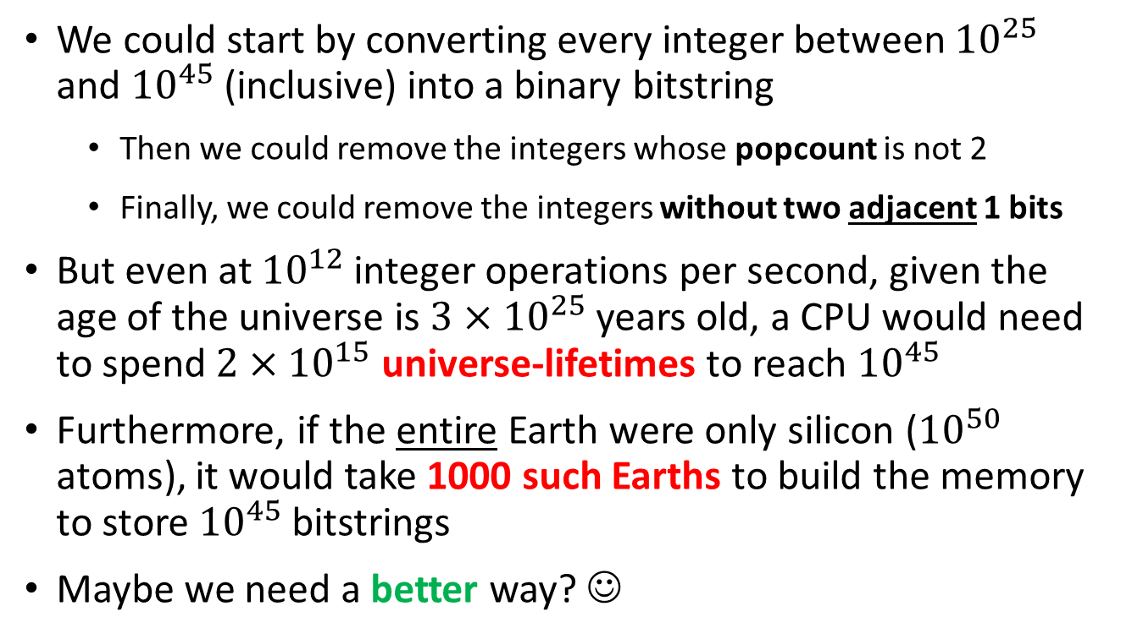
The Scale of Large Numbers
We could start by converting every integer between ${10}^{25}$ and ${10}^{45}$ (inclusive) into a binary bitstring
Then we could remove the integers whose popcount is not 2
Finally, we could remove the integers without two adjacent 1 bits
But even at ${10}^{12}$ integer operations per second, given the age of the universe is $3×{10}^{25}$ years old, a CPU would need to spend $2×{10}^{15}$ universe-lifetimes to reach ${10}^{45}$
Furthermore, if the entire Earth were only silicon (${10}^{50}$ atoms), it would take 1000 such Earths to build the memory to store ${10}^{45}$ bitstrings
Maybe we need a better way? ☺

Slide 30
Two Adjacent Bits
How many natural numbers $≤255$ have only two adjacent bits?
Count = 7
We start with 3, which has a popcount = 2 and two adjacent 1 bits
We then multiply that by 2, which is equivalent to shifting the value to the left by one binary position
We count how many times we can do this multiplication within the requested interval [low, high]
The final count is the number of integers that satisfy the requirement

Slide 31
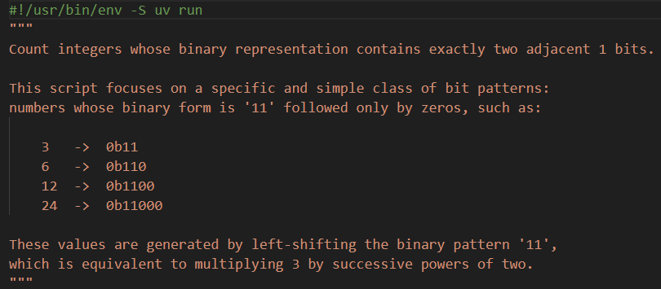
Open two_adjacent_bits.py
DO NOT edit
this code
①
②

Slide 32
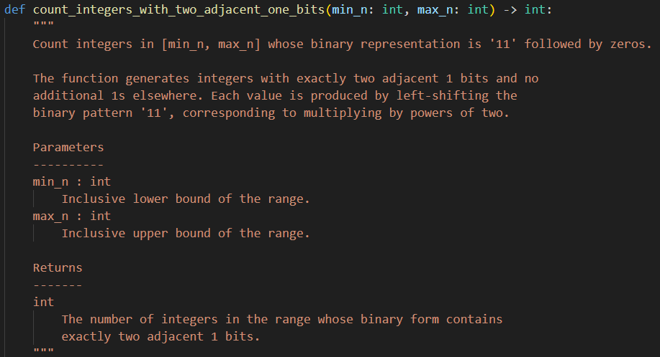
View two_adjacent_bits.py
DO NOT edit
this code
①
②

Slide 33
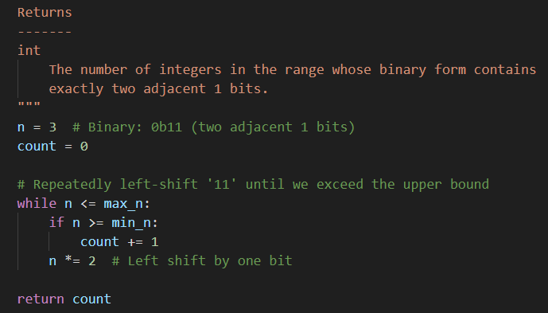
View two_adjacent_bits.py
DO NOT edit
this code
①
②
③
④
⑤
⑥
⑦

Slide 34
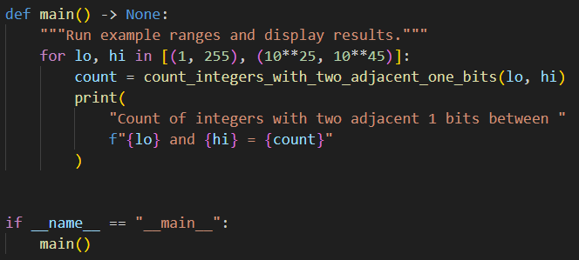
View two_adjacent_bits.py
DO NOT edit
this code
②
③
④
⑤
①

Slide 35

Run two_adjacent_bits.py
①
②
$$\left|\left\{n∈ℕ,{\left\|n\right\|}_{1}=2,{10}^{25}≤n≤{10}^{45} \right\}\right|=66$$
${\left\|n\right\|}_{1}=$ The $ℓ_{1}\text{‐}norm$ of a binary vector, which equals the number of 1s
$\left|\left\{ \right\}\right|=$ The number of elements in the set

Slide 36
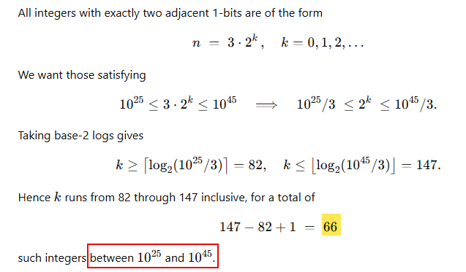
Always Seek Independent Confirmation

Slide 37
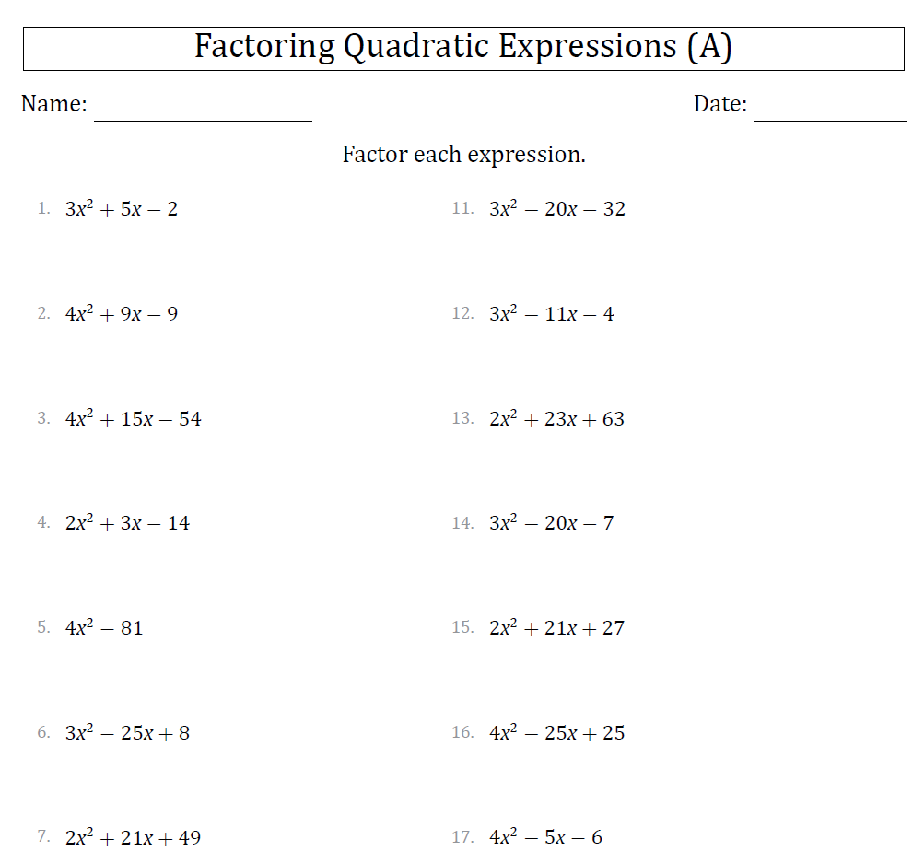

Slide 38

Factoring a Quadratic Polynomial
Write a Python console application to display the integer factorizations of a given quadratic polynomial
$$Jx^{2}+Kx+L=0$$
You may assume in all cases $\{J, K, L\} ∈ ℤ^{+}$
Your scientist needs you to factor this quadratic:
$115425x^{2}+3254121x+379020$
Can we use the quadratic formula to factor this quadratic?
In general, what is the difference between factoring a quadratic versus using the quadratic formula?

Slide 39
Representing a Quadratic Polynomial
The Fundamental Theorem of Algebra shows a polynomial of degree 2 will have exactly 2 roots
$Jx^{2}+Kx+L=0$, the roots can be unique or repeated
Either the roots can be a real or a complex conjugate
Work backwards by starting as a factored a quadratic:
$$\left(ax+b\right)\left(cx+d\right)=0$$
$$\left(ac\right)x^{2}+\left(ad+bc\right)x+\left(bd\right)=0$$
$$Jx^{2}+Kx+L=0$$
$$J=(ac), K=\left(ad+bc\right), L=(bd)$$

Slide 40
Factoring a Quadratic Polynomial
$$Jx^{2}+Kx+L=0$$
$$J=\left(ac\right), K=\left(ad+bc\right), L=\left(bd\right)$$
To factor $J$ we need to try every integer $a$ where 1 ≤ $a$ ≤ $J$
If $J$ % $a$ == 0 (no remainder) then set $c$ = $J$ / $a$
To factor$L$ we need to try every integer b where 1 ≤ b ≤$L$
If$L$% $b$ == 0 (no remainder) then set $d$ =$L$/ $b$
If $\left(ad+bc\right)==K$ then we have found a factorization!
If the sum does not equal $K$, then we have to keep trying more factors

Slide 41
if Statement
An if statement identifies which code block (scope) to run based upon the value of a Boolean expression
The expression (the condition) must evaluate to either a True or a False value
If the condition is True, then the scope immediately following the if statement is executed
If the condition is False, and there is an else clause, then the scope immediately following the else statement is executed
Every if statement does not need to have an else clause
You can also use elif to continue to test for other conditions
The if, elif, and else statements all introduce scopes (meaning they require a colon at the end of their line)

Slide 42
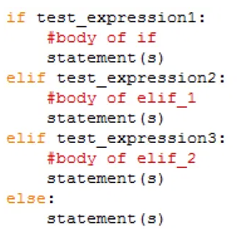
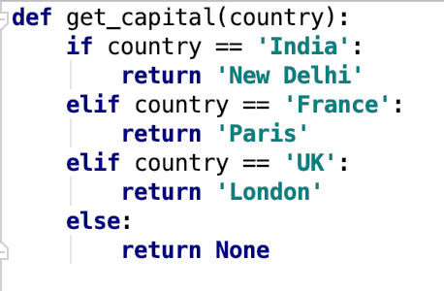
if Statement
def is how we define a function
Functions can return values
Be mindful of the colons : that start the scopes

Slide 43
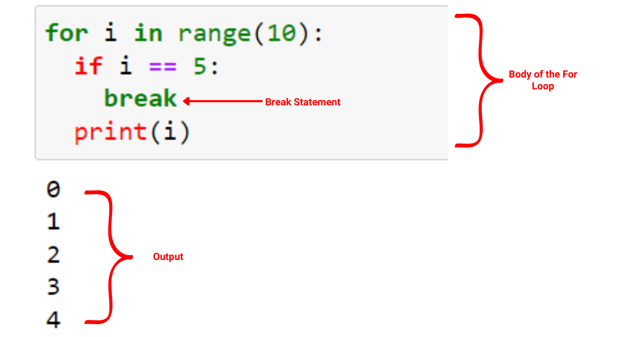
if Statement
The break statement immediately exits from the closest enclosing loop structure
What would be the output?

Slide 44
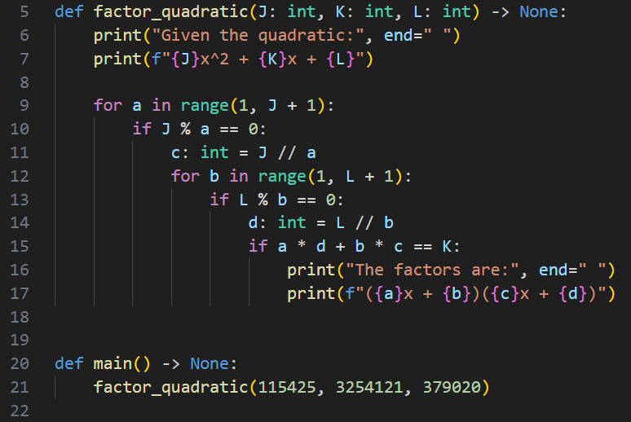
Edit factor_quadratic.py
③
④
YOU MUST ENTER ALL THIS CODE
⑤
⑥
⑦
⑧
⑨
⑩
①
②

Slide 45
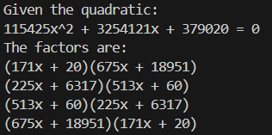
Run factor_quadratic.py
$$115425x^{2}+3254121x+379020$$
The code is not smart enough to recognize the commutative and distributive properties of multiplication, so it lists several legal but redundant factors
The code should also first factor out the GCD shared between all the coefficients
$gcd\left(115425, 3254121, 379020\right)=3$

Slide 46
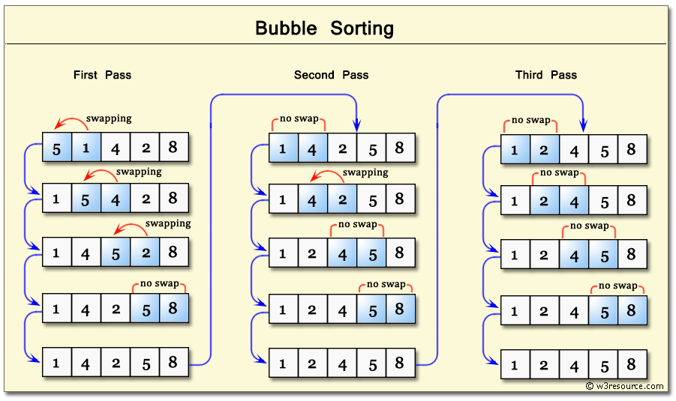
Bubble Sort

Slide 47
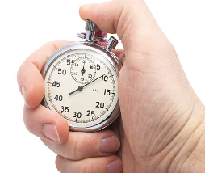
Instrumenting Your Code
Instrumenting code is the process of taking accurate timings of the runtime performance of key algorithms within the program
Python provides a time.perf_counter() object that can measure the current CPU time of a running process to the nearest millisecond (1/1000th of a second), which is sufficient in most situations
We bracket the code under analysis by measuring the clock immediately before the start and again after the end of the algorithm to calculate the elapsed time
Careful tracking of code timings will provide objective empirical evidence if changes to algorithms and/or data structures are indeed making the program more efficient

Slide 48
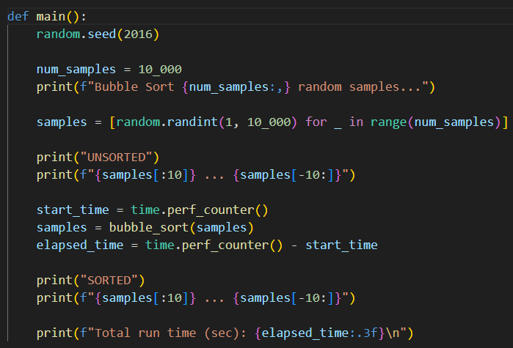
Open bubble_sort.py
①
②
③
④
[start:stop:step]
First 10
Last 10
⑤
⑥
⑦
⑧
⑨
Slicing and Indexing in Python

Slide 49
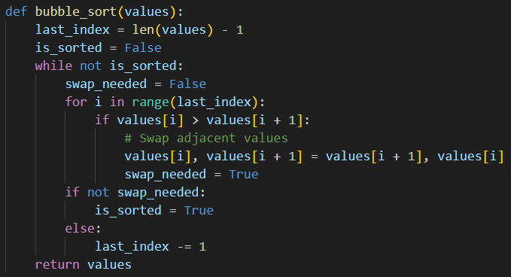
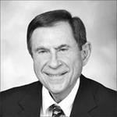
View bubble_sort.py
①
②
③
④
⑤
⑥
⑦
⑧
⑨
⑩
Invented 1956
Edward Friend
(1929-2019)

Slide 50
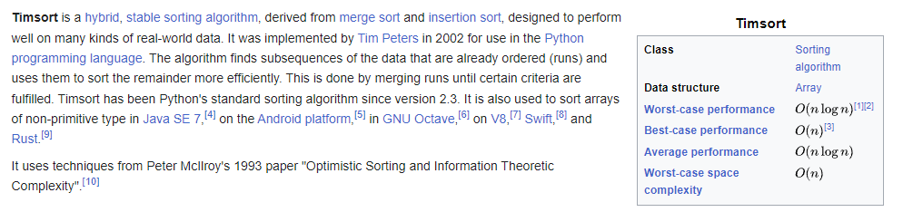
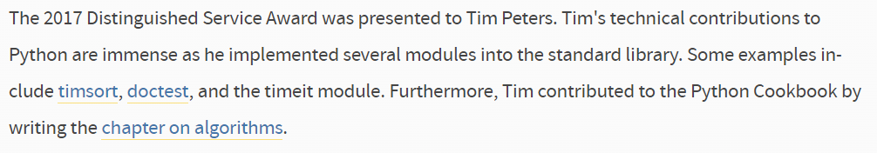
Timsort

Slide 51
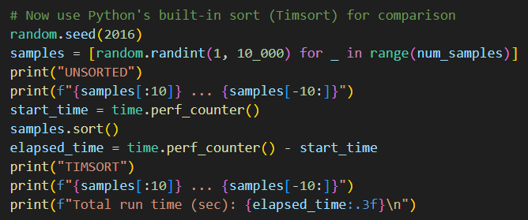
View bubble_sort.py
①
②
③
④
⑤
⑥
⑦
⑧

Slide 52
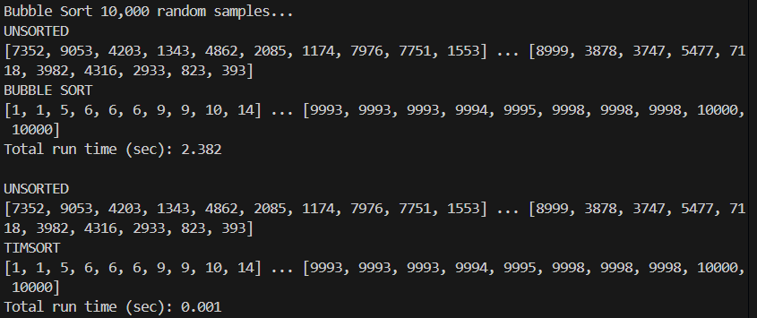
Run bubble_sort.py
①
②
③
④
⑤
⑥

Slide 53
Session 04 – Now You Know…
The syntax and motivation for the Unix shebang and docstrings
How to utilize the main guard and a main() function to clearly designate the place where your Python script starts
How to define a custom (user-defined) function using the def keyword
How to convert integers to and from Base 10 (decimal) and Base 2 (binary)
How to implement a while loop to repeatedly execute code until a test condition obtains a desired value

Slide 54
Session 04 – Now You Know…
What is the Hamming weight (popcount) of an integer, and how to efficiently scan for integers with adjacent 1-bits
How to write code to factor a quadratic expression
How to implement an if/else clause to support conditional code execution
How to sort a list of integers using the Bubble Sort algorithm
How to instrument code to time its performance for comparative reference to potentially faster algorithms

Slide 55
Task 04
Create a new Python program called octal_converter.py
Use the existing program base_conversion.py as a model
Convert the octal number 2323 to base 10 (decimal) by looping, and display both numbers
Then convert the decimal number you calculated above back to octal by looping, and display both numbers

